Slide 1
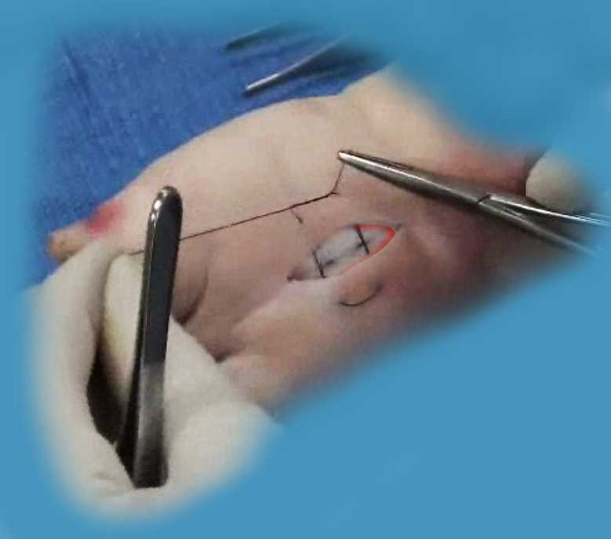
Suturing Basic & Advanced Principles

Slide 2
Discussion points
aseptic vs sterile technique
common surgical instruments
choice of anesthetic
preparing the wound
correct knot tying methods
wound closure with a variety of suturing techniques
common pitfalls
practical tips on improving your technique
guidelines for choosing the correct suture and needle

Slide 3
Wound healing and scars
The goal of optimal wound closure is to obtain a fine line scar that maintains both the form and appearance of the tissue.
It is important to let your patient know that any time there is an an incision there is going to be a scar. However with careful technique and close attention to tissue integrity this scar can be minimized.
Know when it is a closure that you should not attempt e.g. lip, eyelid, across a joint, tendon involved, or the web space of a hand.

Slide 4
Preparation
Plan the incision or type of closure
Gather equipment – irrigation, syringes, anesthetic, instruments, suture, drapes, dressing
Time out:
Check patient name and sign a consent
Check what procedure is to be done
Scrub, glove, and drape
Prepare the skin – betadine on the outside
Local anesthetic – lidocaine or bupivacaine
Debridement or incision
Undermining where necessary

Slide 5
Start in the center and swab in circles going outward

Slide 6
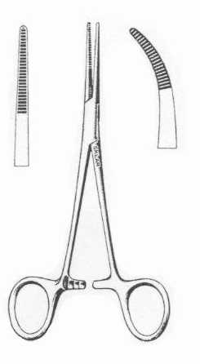
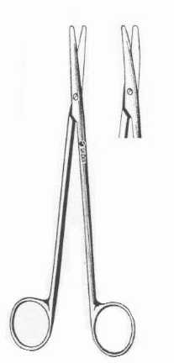
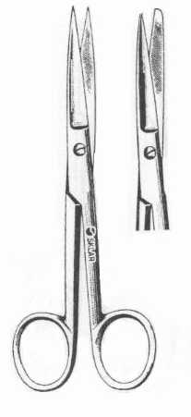
Instruments
adison forcep hemostat metzenbaum scissors suture scissors

Slide 7
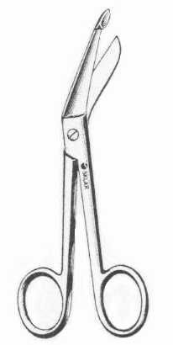
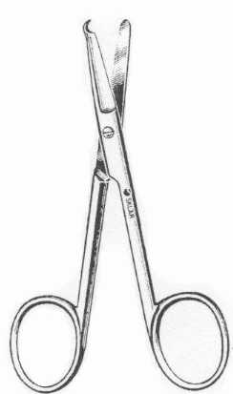
Instruments
Needle holders
blade handle
suture removal scissors
bandage scissors

Slide 8
Sterile instruments
Instruments been sterilized and packed in sterile packages
Indicator tape changes color with proper sterilizing
Packages must remain sealed or double wrapped
Sterilize with:
Autoclave 15- 20 psi 220 to 250 degrees F
Gas
Liquid

Slide 9
Anesthetic
Lidocaine 1% or 2% - inject locally or a regional block
gives anesthesia and reduces muscle movement
Bupivacaine (Marcaine) 0.25% or 0.5%
gives anesthesia only
lidocaine and bupivacaine can be mixed half and half
Epinephrine can be added to increase anesthetic time and decrease bleeding – don’t not use on, nose, toes, fingers, hose (penis)
May be buffered - 9:1 with sodium bicarbonate, to reduce pain on injection (e.g. remove 2 mL of 1% lidocaine from 20 mL vial, and add 2 mL of sodium bicarbonate solution to vial)

Slide 10
Anesthetic
Local Lidocaine (Xylocaine)1% or 2%
Onset: 2 minutes
Duration: 1.5 to 2 hours
Action : anesthesia and reduced muscle movement
Max dose: 4 mg/kg to 280 mg (14 ml 2%, 28 ml 1%)
Lidocaine with Epinephrine 1:100,000 or 1:200,000
Onset: 2 minutes
Duration: 1 – 3 hours
Action : anesthesia and reduced muscle movement
Max dose: 7 mg/kg to 500 mg (25 ml 2%, 50 ml 1%)
Bupivacaine (Marcaine) 0.25%
Onset: 5 minutes
Duration: 2 to 4 hours
Action : anesthesia only
Max dose: 2.5 mg/kg up to 175 mg (50 ml 0.25%, 25 ml 0.5%)

Slide 11
Basic knot tying
1
2
3
4
1 – square knot
2 – granny knot
3 - slip knot
4 – surgeon’s knot

Slide 12
Instrument tying

Slide 13
Surgical Wound Closure Guidelines
Adequate debridement and hemostasis
Atraumatic technique
Alignment with the relaxed skin tension lines
Angle of incision
Perpendicular to skin surface or slightly undermined
Angle incisions parallel to hair shafts
Consider area of the body for vascularity and tension on the wound

Slide 14
Key Techniques
Close dead space under the incision
Close the tissue in layers
Carefully align the wound edges
Careful choice of the axis of incision or axis of closure of the donor skin flaps
Correct choice of deep and cutaneous sutures

Slide 15
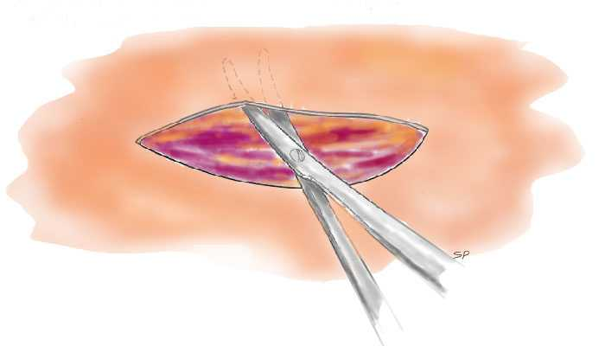

Slide 16
Bleeding
Control with pressure directly over the wound immediately
Locate the nearest artery and put pressure there to give yourself room to work
If necessary, tie off the bleeding vessel
Use a pressure bandage

Slide 18
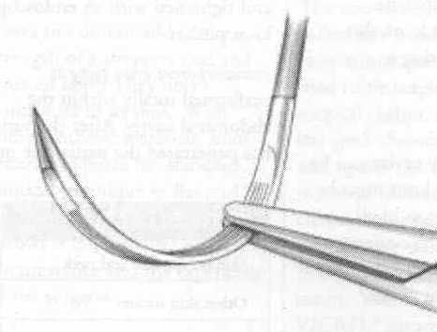

Slide 19
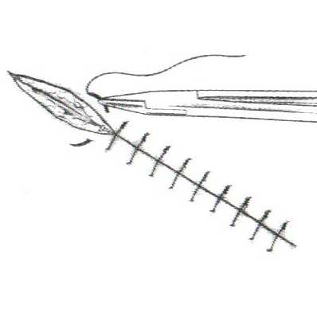

Slide 20
Simple Interrupted Sutures
This suture is used for simple laceration closures or closure of office procedures like biopsies or lesion removals
It is also the basic suture used inside the wound to close deep sutures
It is useful in that a few sutures can be removed at a time instead of all at once to allow for slower sound healing

Slide 21
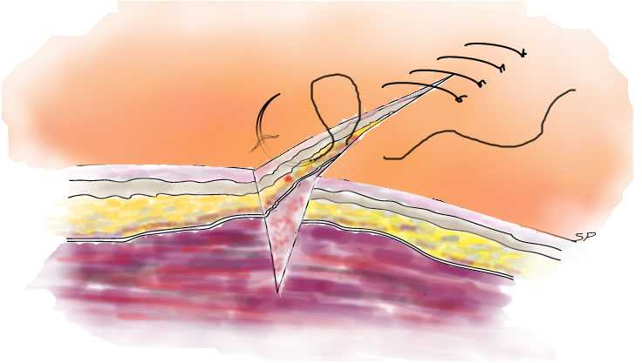

Slide 22
Continuous Sutures
The continuous suture as its name suggests, only has a knot at the beginning and the end
There are several methods of continuous suture – locking and non-locking
The knots must be very secure and minimal tesion on the wound or the wound will come apart if one loop or knot gives way
The advantage is that it is very quick and the wound tension is even across the wound

Slide 23
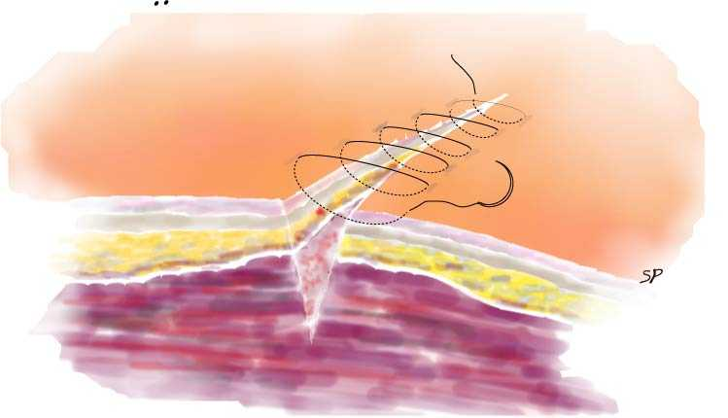

Slide 24
Horizontal Mattress Suture
Used with wounds with poor circulation
Helps eliminate tension on wound edges
Requires fewer sutures to close a wound
Can be placed quite quickly
Can be done as a continuous suture

Slide 25
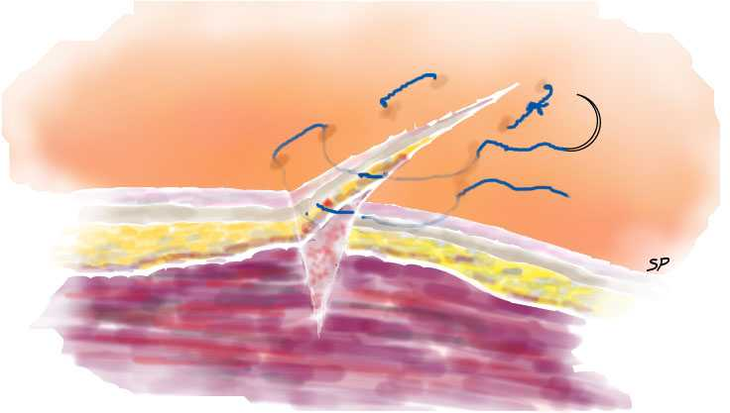

Slide 26
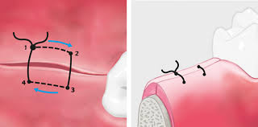

Slide 27
Vertical Mattress Sutures
Deep and shallow approximation of the tissue
Can be used for wounds under tension
Can be useful with lax tissue e.g. elbow and knee
Should not be used on volar surface of hands or feet or on the face because of blind placement of the deep part of the suture

Slide 29
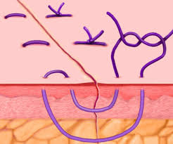

Slide 30
Sub-Cuticular Closure
Used for cosmetic closures
Use an absorbable suture if you plan to leave the sutures in and bury the knots
Use either nylon or prolene (best) and keep the suture sliding while you are closing. The suture then can be easily removed with no exterior marks. The ends can be taped or a knot on the skin
At each entry point, enter across form the last exit with slight overlap

Slide 31
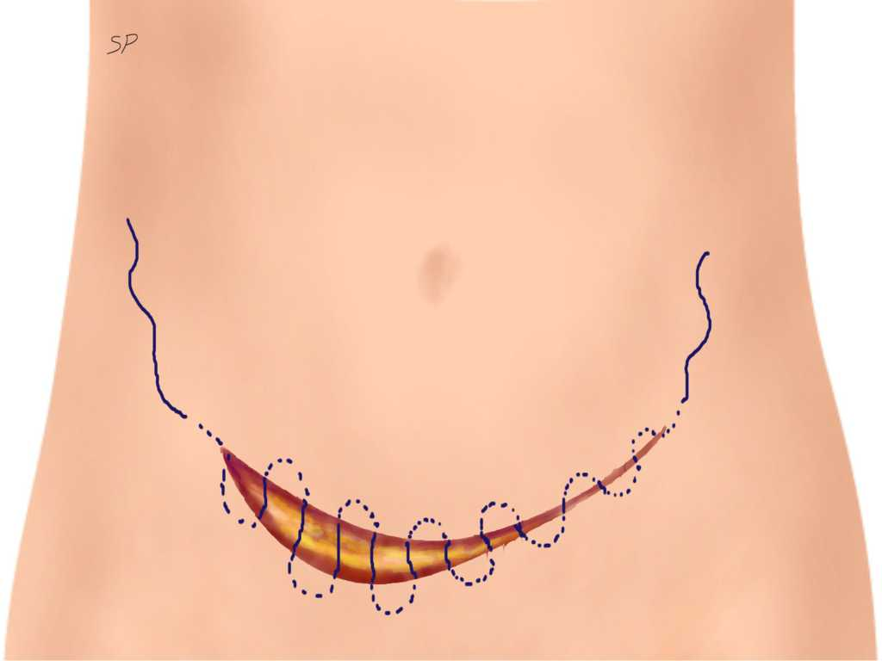

Slide 32
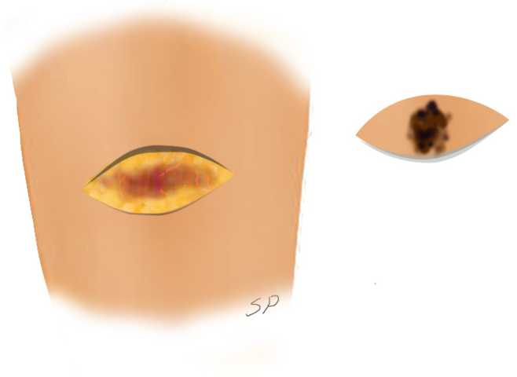
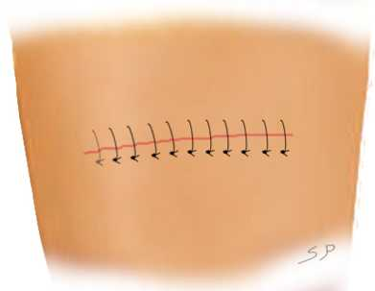
Elliptical Incision
The ellipse should be three times as long as it is wide. This will make closure of the wound much easier. If the lesion you are removing is likely to be cancerous, make sure that you leave wide margins of clear skin around the lesion.

Slide 33
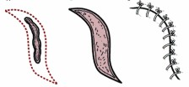
Modified Ellipse

Slide 34
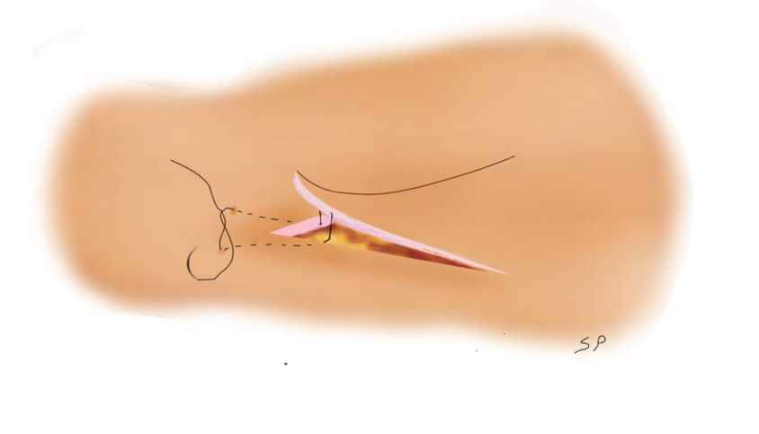
3 Cornered Suture
Used to close a skin flap which comes to a point
Helps close the wound, but maintain circulation to the tissue
Places minimal tension on the wound edges

Slide 35
Suture Materials
Suture material | filament | Absorbing properties | Tissue reaction | Tensile strength | Tensile strength retention | cost | Uses
plain gut | collegen | absorbable | moderate | poor | 2-4 days | low | Inside the wound where it absorbs and wound healing is quick
chromic gut | collegen | absorbable | moderate | poor | 7-10 days | low | Inside the wound where it absorbs and wound healing time is average length
polygalactic acid (Vicryl) | braided | absorbable | mild | poor | 2-3 weeks | moderate | Inside the wound where it absorbs and longer wound healing time is required, such as tendons.
silk | braided | Non-absorbable | high | poor | 1year | low | Skin closure or fascia
nylon | monofiliment | Non-absorbable | Very low | good | Loses 20%/yr | low | Skin closure or fascia or where long term strength is needed
Polypropylene (Prolene) | monofiliment | Non-absorbable | minimal | excellent | indefinite | high | Sub-cuticular skin closure or fascia or where permanent strength is needed.
Polyester (Mersilene) | braided | Non-absorbable | minimal | good | indefinite | high | Internally where low reaction braided suture is required to allow tissue to adhere to it.
stainless steel | monofiliment | Non-absorbable | low | excellent | indefinite | moderate | Bone , tendons, strong connective tissue where permanent strength is required

Slide 36
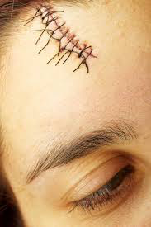
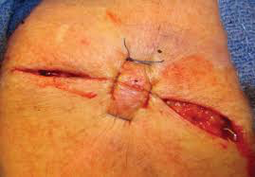

Slide 37
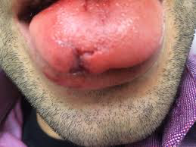
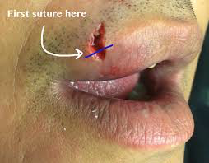
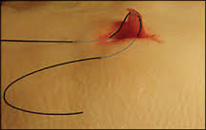
Non linear repairs

Slide 38
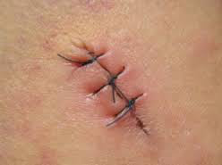
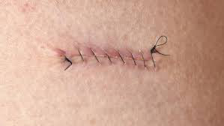
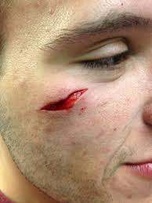

Slide 39
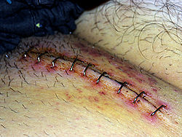
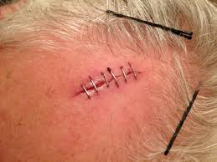

Slide 40
Skin Tear Repair

Slide 41
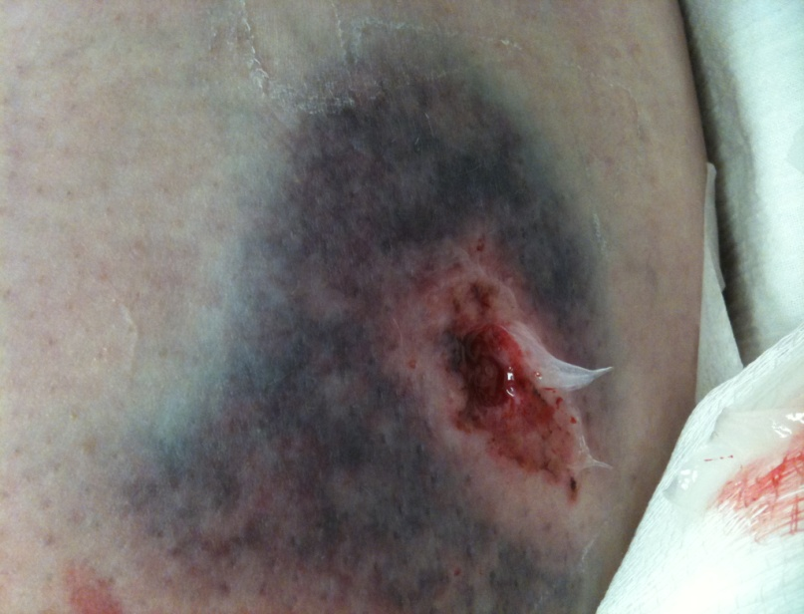
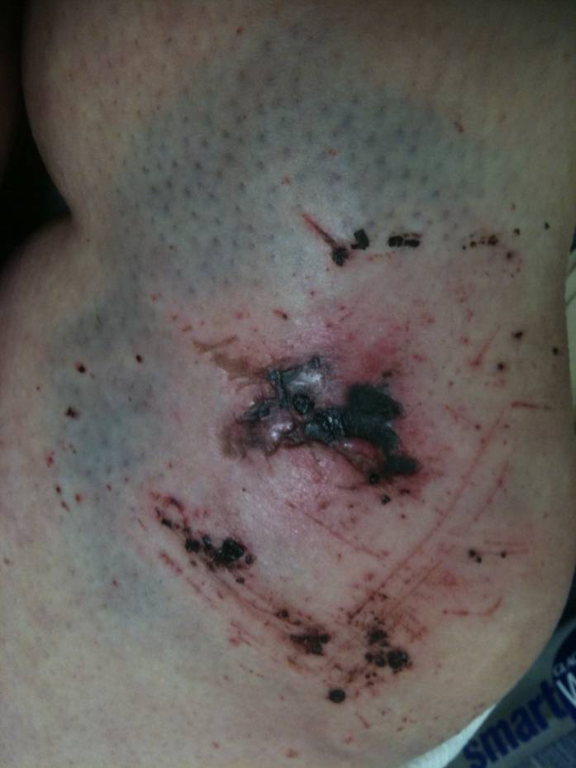
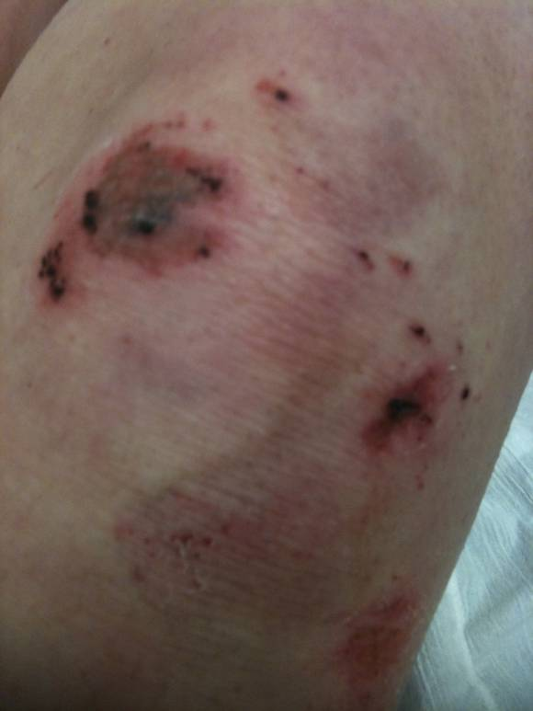
Foreign Body

Slide 42
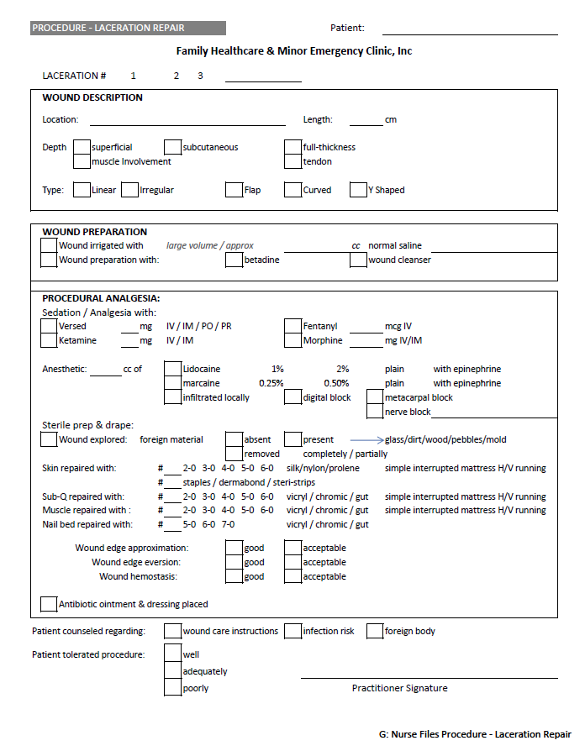

Slide 43
Care of the patient
How will you care for your patient and maintain a safe environment?

Slide 44
Discharge Instructions
Antibiotic Therapy and for how long
Wound Care
Return Visits
Suture Removal
Post Suture Removal Care

