Slide 1
Joint Injection Techniques
Brian Coleman, M.D.
OU Family Medicine
22 SEP 2021

Slide 2
Relevant Disclosure
Under Accreditation Council for Continuing Medical Education guidelines disclosure must be made regarding relevant financial relationships with commercial interests within the last 12 months.
Brian Coleman, M.D.
I have no relevant financial relationships or affiliations with commercial interests to disclose.

Slide 3
Learning Objectives
To describe the benefits and risks of joint injection
To identify situations when joint injections should not be performed
To identify the unique anatomy of commonly injected joints which allows for successful joint injection
To demonstrate the appropriate techniques for performing injection of shoulder and knee

Slide 4
General Principles
Anatomical placement
Local anesthetic blocks
Corticosteroid injection vs visco-supplementation vs regenerative (PRP/stem cells/etc)
Rest/restricted use
Adjunctive physical therapy

Slide 5
Inject with caution
Patellar tendon
Achilles tendon
Biceps tendon
Infected joint

Slide 6
Materials
Prep materials
betadine, alcohol preps
Anesthetic
Ethyl chloride
1% lidocaine without epinephrine
Steroid of choice
Syringe

Slide 7
Materials
Needles
Medium hemostat
Post-injection prep
Band-aids, 4 x 4 gauze, 1” tape, elastic wrap
Epinephrine readily available

Slide 8
Benefits to injection
Pain relief, improved function
Viscosupplementation--effective treatment for knee OA of the knee—improved pain, function and patient global assessment (Cochrane meta-analysis)
Insufficient evidence with corticosteroid injections (Cochrane database)
Lidocaine injection into myofascial trigger points appears effective (Cochrane database)

Slide 9
Absolute Contraindications
Local cellulitis
Joint prosthesis
Septic arthritis
Bacteremia
Acute fracture
History of allergy or anaphylaxis to injectable pharmaceuticals or constituents

Slide 10
Relative contraindications
Minimal relief after two previous corticosteroid injections
Underlying coagulopathy
Anticoagulation therapy
Evidence of surrounding joint osteoporosis
Anatomically inaccessible joints
Uncontrolled diabetes mellitus

Slide 11
Side Effects
All patients should be warned about:
30%--soreness or pain after injection (2-3 days, ice, Tylenol)
10%--inflammatory flare reaction (2-3 days, ice, narcotics)
30%--fat or skin atrophy (90% revert to normal in 6-12 months)
Reevaluate if redness, swelling, and pain beyond 3-4 days (infection risk < 1:10,000)

Slide 12
Side Effects
Remember these complications also:
Tendon rupture (if injected into the tendon)
Damage to the cartilage after repeated injection
Can cause a crystalline arthritis

Slide 13
Synovial Fluid
Can’t be aspirated from a healthy joint
Often holds key to diagnosis
Normally, fluid is transparent, doesn’t contain large proteins or clot
Send fluid for analysis, cultures, protein, cell count, and crystals

Slide 14
Synovial Fluid Analysis
Parameter | Normal | Noninflammatory | Inflammatory | Septic
Clarity | Transparent | Transparent | Translucent to opaque | Opaque
Color | Clear | Yellow | Yellow to green | Yellow to green
Viscosity | High | High | Low | Variable
WBC/mm³ | <200 | 200-2,000 | 2,000-150,000 | 15,000-200,000
Polys | <25% | <25% | >50% | >75%
Culture | Negative | Negative | Negative | Usually Positive
Protein (gm/dl) | <2.5 | <2.5 | >2.5 | >2.5

Slide 15
Common Injectable Corticosteroids
Medication | Potency | Onset | Duration
Hydrocortisone (cortisol) | 1 | Fast | Short
Prednisolone terbutate (Hydeltra) | 4 | Fast | Intermediate
Methylprednisolone acetate (Depo-Medrol) | 4 | Slow | Intermediate
Triamcinolone acetonide (Kenalog) | 5 | Moderate | Intermediate
Triamcinolone hexacetonide (Aristospan) | 5 | Moderate | Intermediate
Betamethasone (Celestone) | 25 | Fast | Long
Dexamethasone sodium phosphate (Decadron) | 25 | Fast | Long

Slide 16
Usual Doses of Methylprednisolone or Equivalent by Site
Dose | Anatomic site
5 to 10 mg | Phalangeal joints
20 to 30 mg | Wrist
20 to 30 mg | Elbow and ankle
40 to 80 mg | Shoulder, hip, or knee

Slide 17
Common Injection Sites
Shoulders
Knee
Elbow
Hand and wrist
Hip
Foot and ankle
Trigger points

Slide 18
Shoulder
Three locations
Subacromial/subdeltoid bursa
Impingement, rotator cuff tear
Acromioclavicular joint
osteoarthritis
Glenohumeral joint

Slide 19
Subacromial Bursa
Palpate the acromion and posterior humeral head
Use 1.5” 25 gauge needle, instilling 10 cc of steroid/anesthetic combo
Enter posteriorly aiming toward the coracoid process anteriorly
Enter laterally, pulling down on the arm to open the joint up, aiming slightly upward under the acromion

Slide 20
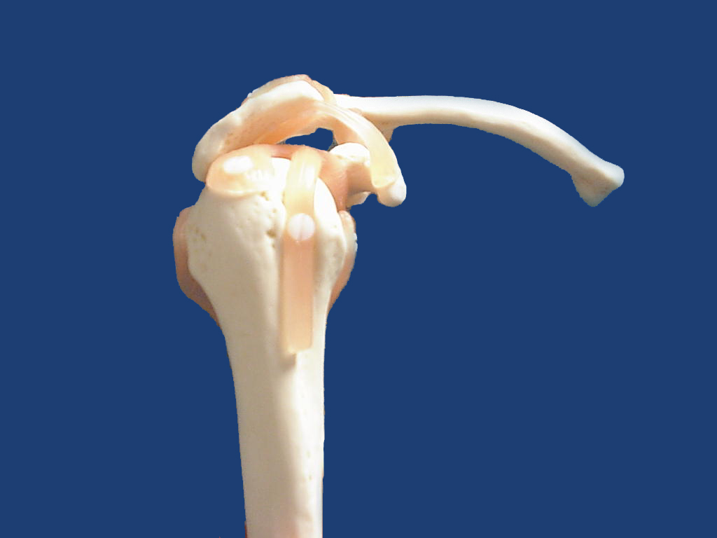
Subacromial bursa

Slide 21
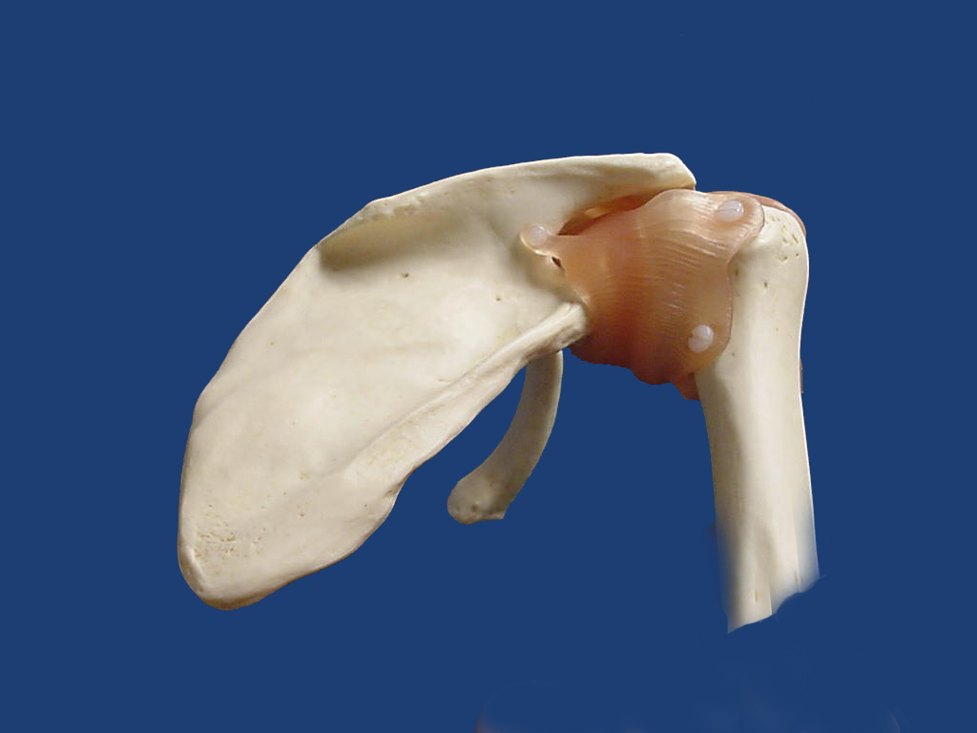

Slide 22
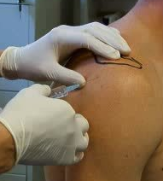

Slide 23
Acromioclavicular Joint
Palpate distal edge of clavicle, proceed until you feel a bump (this is the joint)
Insert 1” 25 gauge needle from posterior surface, angle medially (will feel needle slip into place)
Use small volume, 2-5 ml of steroid-anesthetic combination

Slide 24
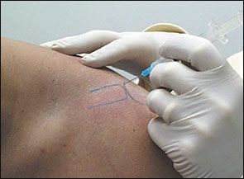

Slide 25
Elbow
Common reasons for injection/aspiration of the elbow:
Lateral/medial epicondylitis
Olecranon bursitis
Degenerative arthritis

Slide 26
Epicondylitis
Locate most tender area. Insert 1.5” 25 gauge needle at 90º angle, go down to the periosteum and begin injecting into it (key to a good response), withdraw slightly and complete infiltration
Be careful to not infiltrate the ulnar or radial nerve
Massage medication into the region to disperse
Rest for 7-10 days

Slide 27
Olecranon Bursitis
Elbow 90º of flexion, insert the needle from the back of the elbow, parallel to ulna posterior
Use larger needle (20 or 22 gauge)
If fluid is clear, then may use steroids; but if slightly cloudy, don’t

Slide 28
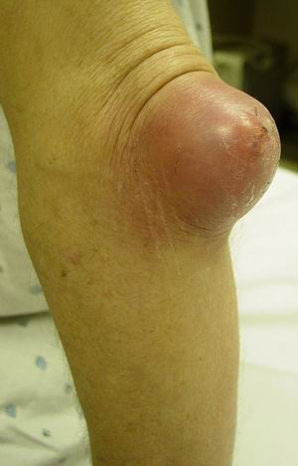
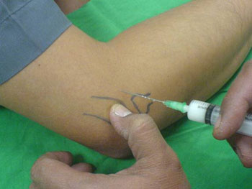

Slide 29
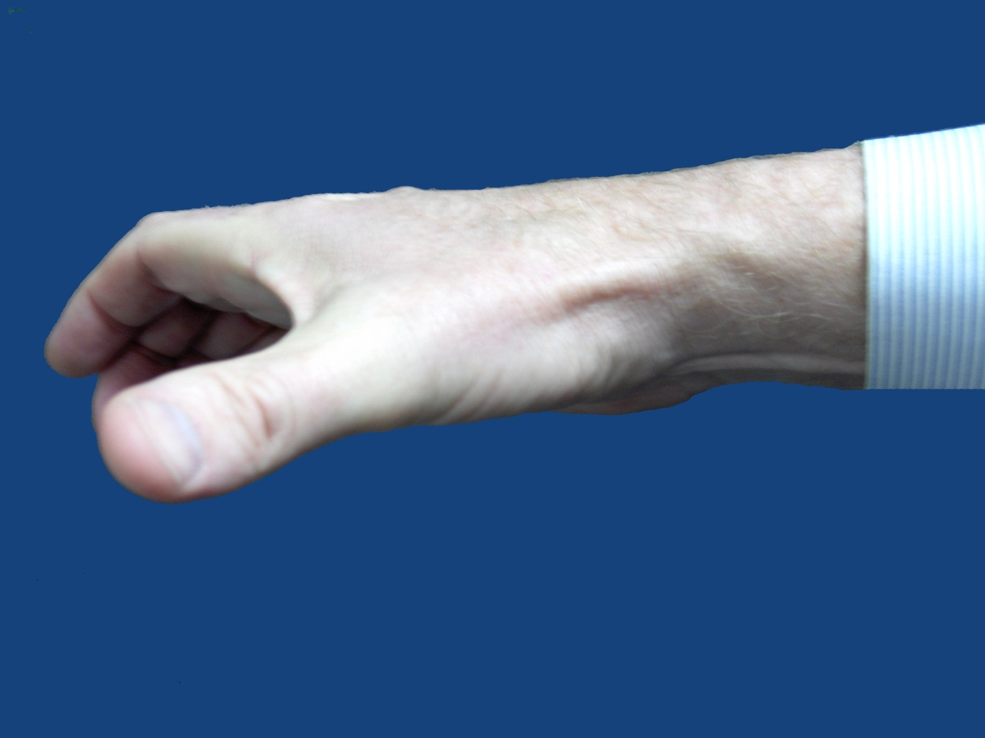
DeQuervain’s Tenosynovitis
Insert 1” 25 gauge needle over the tendon sheath at 45º angle
Should balloon/dilate as infiltrates, signifies medication is in sheath
Abductor pollicis longus

Slide 30
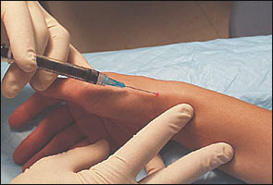

Slide 31
Trigger Finger
Locate nodule by palpating tendon at junction of A-1 pulley, distal to the distal palmar crease
Tendon is very superficial (2-3 mm) deep
Inject on top/volar surface of flexor tendon
50% resolve within days

Slide 32
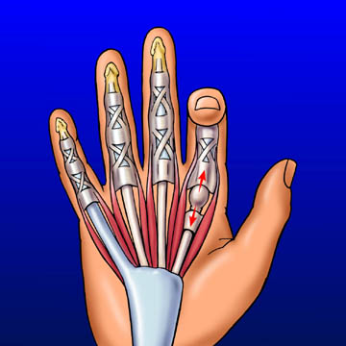
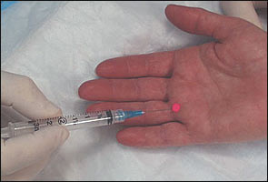

Slide 33
Carpal Tunnel Syndrome
Locate palmaris longus tendon at proximal crease of wrist
Median nerve is directly under tendon
Insert 1.5” 25 gauge needle just ulnar to tendon using 45º angle, aiming distally
Begin injecting when 1” deep
If feels pain or tingling, need to reposition needle

Slide 34
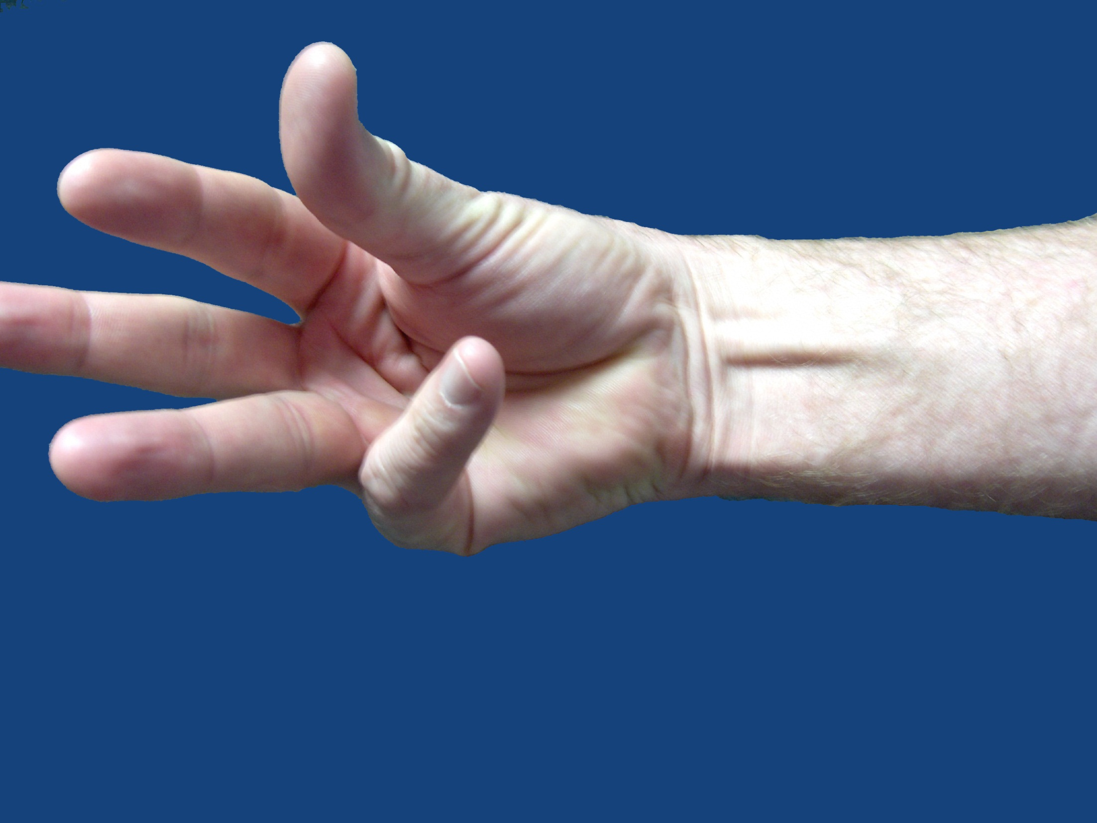
Palmaris longus
Injection site

Slide 35
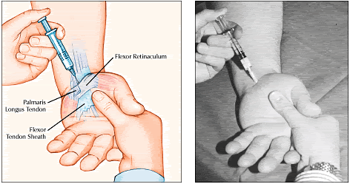

Slide 36
Knee Two Common Methods
Knee extended
Palpate superior pole of patella
Insert needle laterally/medially just deep to patella into suprapatellar pouch
Knee flexed
Insert needle at the level of inferior pole, lateral/medial to the patellar ligament into intercondylar notch
Aspiration = 18-20 gauge 1.5”
Injection = 22 gauge 1.5” needle

Slide 37
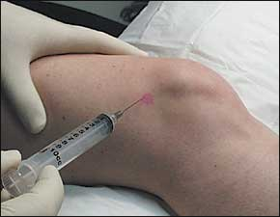
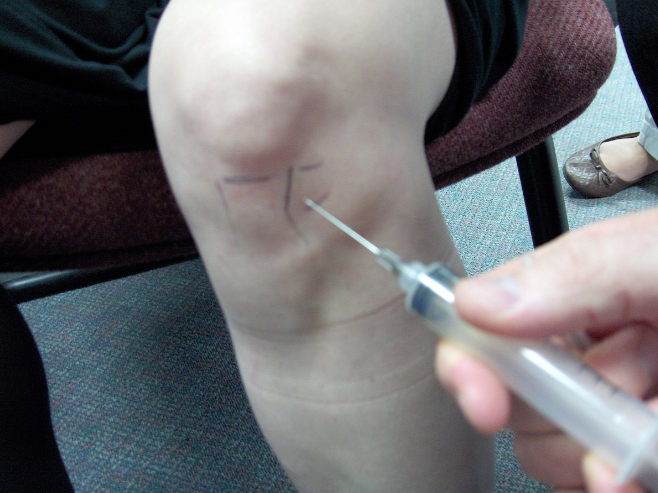
Patellar
tendon

Slide 38
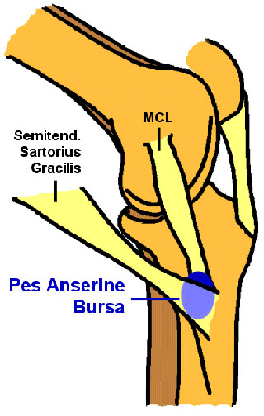
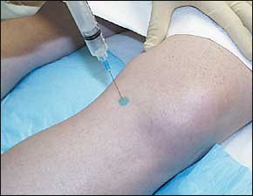

Slide 39
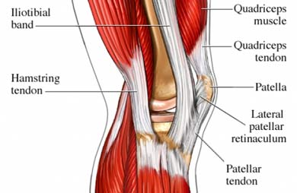
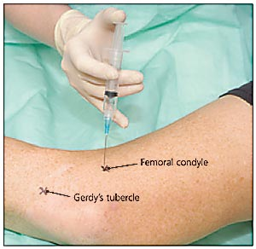

Slide 40
Hip
Intra-articular joint injection → orthopedic referral
Greater trochanteric bursitis
Patient lay on their side with affected side up
Palpate area of maximal tenderness
Insert 3.5” 25 gauge spinal needle down to periosteum, infiltrate some on periosteum and withdraw slightly to complete

Slide 41
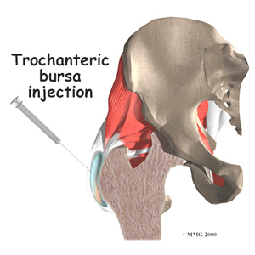

Slide 42
Ankle
Aspiration = 1.5” 18 gauge;
Injection = 1.5” 25 gauge needle
Insert needle 0.5 cm lateral to medial malleolus and medial to extensor hallucis longus tendon
Direct the needle toward dome of the talus

Slide 43
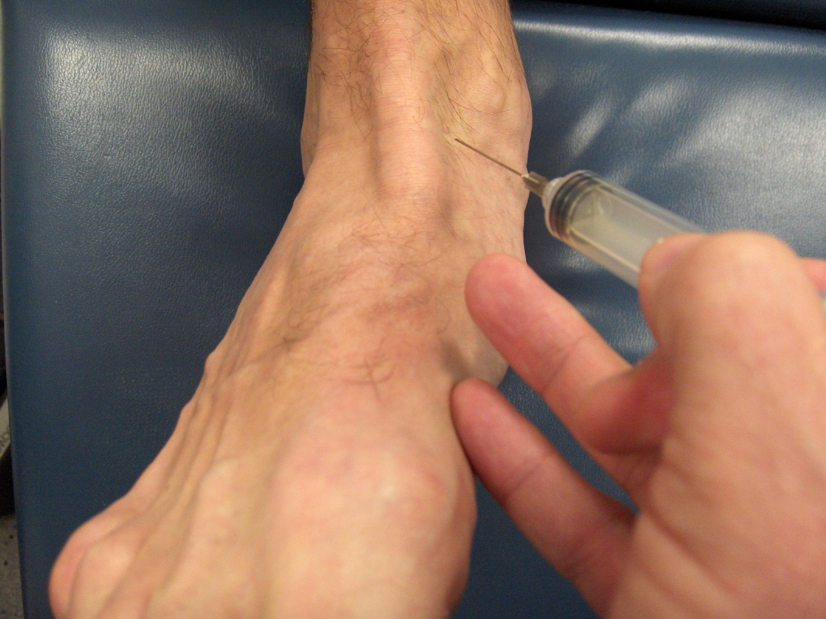
E
H
L

Slide 44
Ankle Subtalar Arthritis
Inject into the sinus tarsi on the lateral aspect of the ankle, just below the lateral malleolus
Inverting the foot will help to locate the space
Use a 1½” 25 gauge, direct needle posterior and medially, as you walk off the talus of calcaneus
Can use 5-10 ml anesthetic-steroid mixture

Slide 46
Foot Plantar Fasciitis and Heel Spurs
Locate point of maximal tenderness on plantar heel, go deep to the bone
Avoid fat pad as can cause fat atrophy

Slide 47
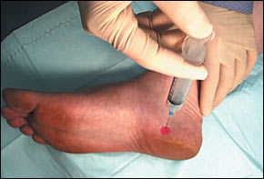

Slide 48
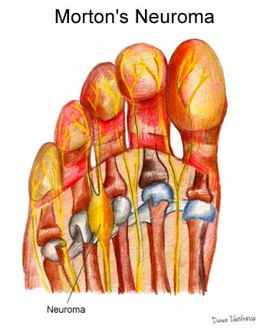
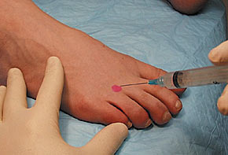

Slide 49
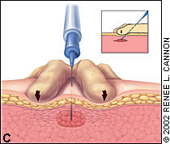
Trigger points

Slide 50
Coding issues
20600 Arthrocentesis, aspiration and/or injection. small joint or bursa. (eg, finger, toes)
20605 intermediate joint or bursa (eg, temporomandibular, acromioclavicular, wrist, elbow or ankle)
20610 major joint or bursa (eg, shoulder, hip, knee)
20526 Injection, therapeutic (eg. local anesthetic, corticosteroid), carpal tunnel.

Slide 51
Coding Issues (cont)
20550 Injection(s), single tendon sheath, or ligament, aponeurosis (eg, plantar "fascia')
20551 single tendon origin/insertion
20552 Injection(s), single or multiple trigger point(s)
20553 single or multiple trigger point(s), three or more muscle(s)

Slide 52
Conclusions
Understand risks and benefits of aspiration and injections
Anatomic placement important
Easy procedure to add to your armamentarium

